Slide 1
Correlation and
Graphical Analysis

Slide 2
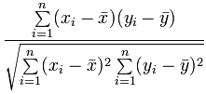
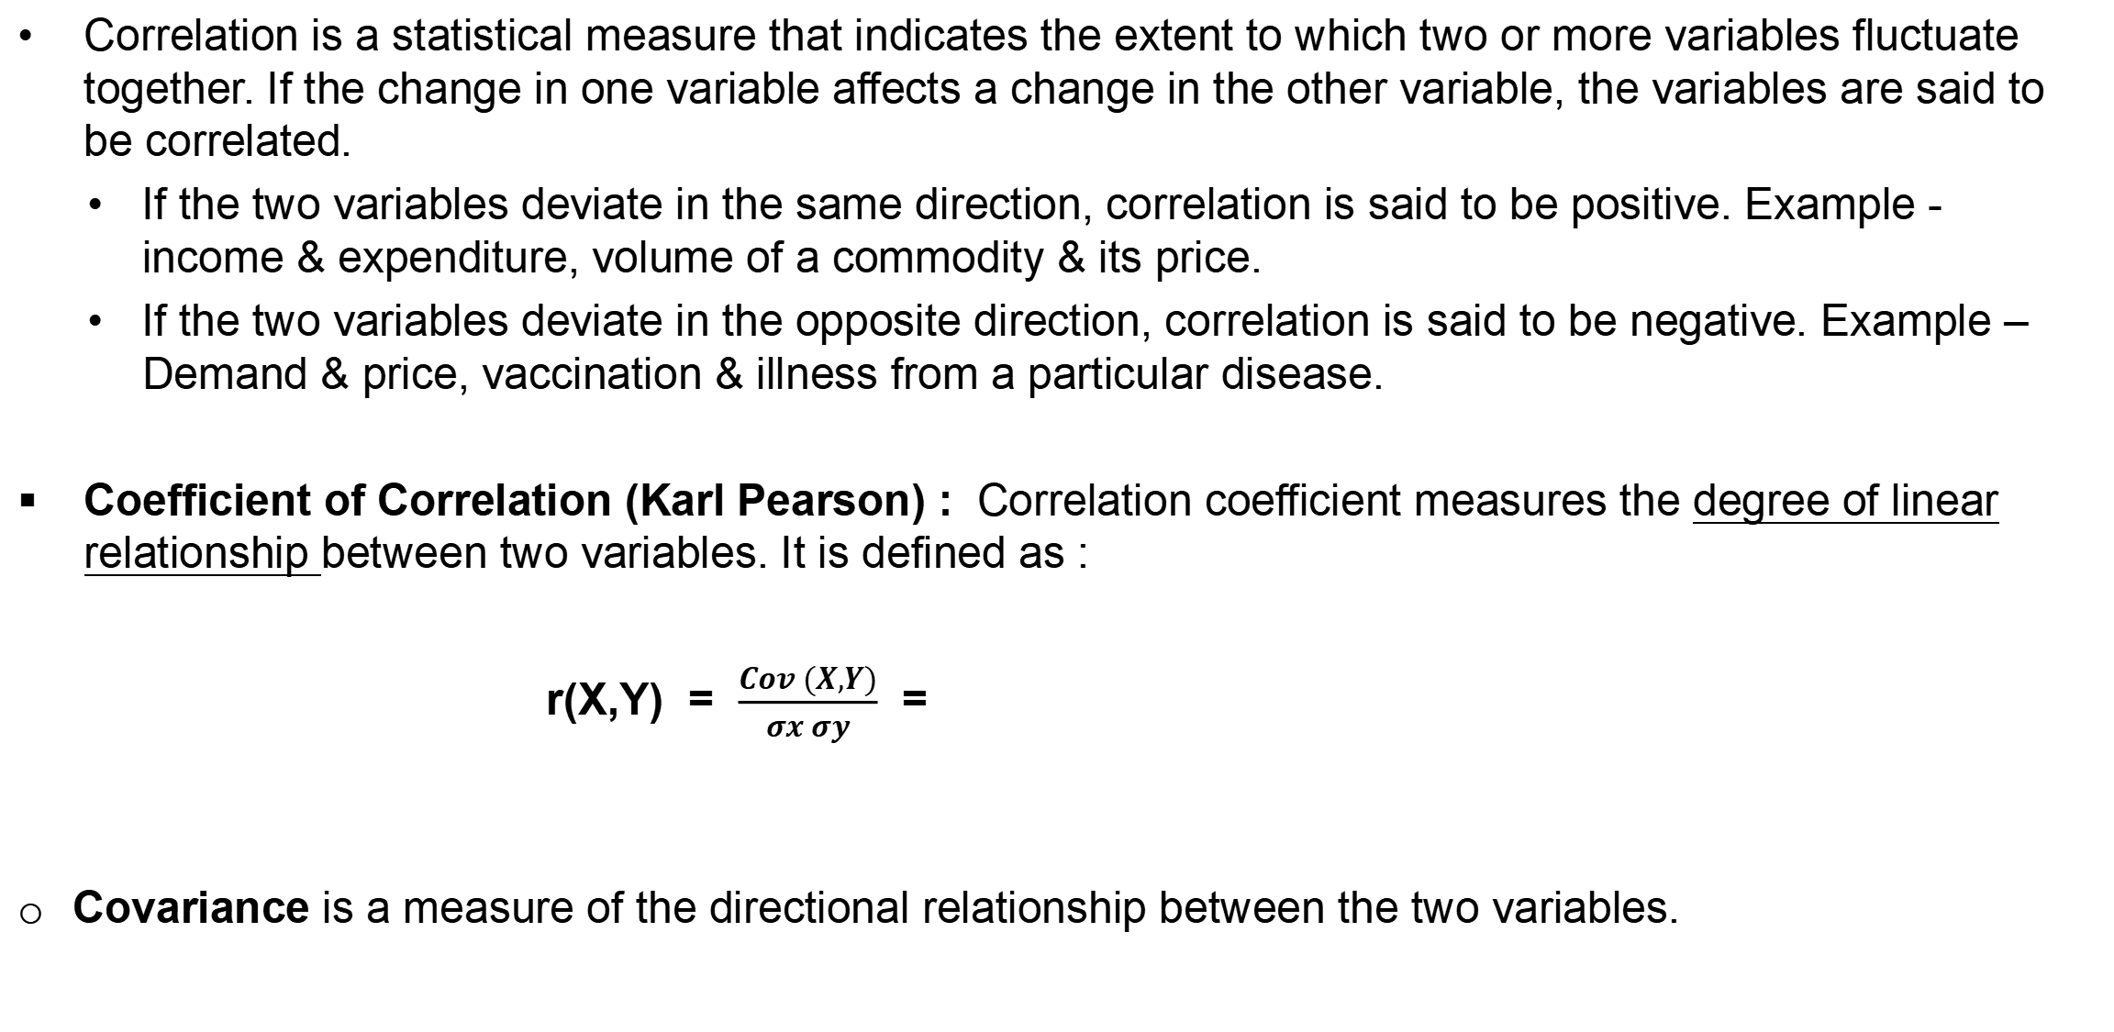
Correlation
Correlation is a statistical measure that indicates the extent to which two or more variables fluctuate together. If the change in one variable affects a change in the other variable, the variables are said to be correlated.
  If the two variables deviate in the same direction, correlation is said to be positive. Example - income & expenditure, volume of a commodity & its price.
  If the two variables deviate in the opposite direction, correlation is said to be negative. Example – Demand & price, vaccination & illness from a particular disease.
Coefficient of Correlation (Karl Pearson) : Correlation coefficient measures the degree of linear relationship between two variables. It is defined as :
r(X,Y) = $\frac{Cov (X,Y)}{σx σy}$ =
Covariance is a measure of the directional relationship between the two variables.

Slide 3
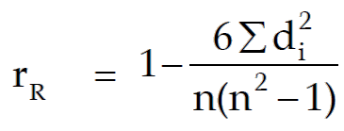
Correlation
Coefficient of Correlation (Spearman) : It is used to check the Rank correlation i.e. the statistical dependence between the rankings of two variables.
Where di is the difference between Xi & Yi, n is the number of observations.
Properties :
-1 ≤ r(X,Y) ≤ 1 : The value of correlation coefficient lies between -1 to 1.
If r = + 1, the correlation is perfect and positive and if r = -1, correlation is perfect and negative. r=0 represents no correlation.
Correlation coefficient is independent of change of origin & scale.
Two independent variables are uncorrelated, but converse it not true.

Slide 4
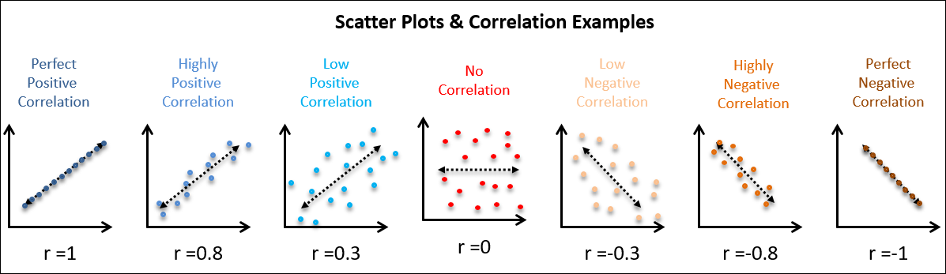
Correlation : Representation
Scatter diagram : Scatter diagram is a simplest way for graphically checking the correlation between two variables.
Interpretation: The value of correlation coefficient can be interpreted as:
If r is close to zero then correlation is said to be very low.
If r is close to -0.5 or 0.5 then correlation is said to be moderate.
If r is greater than 0.75 or less than -0.75 then correlation is said to be high.

Slide 5
Correlation : Things to Remember
Correlation is very simplest way to understand the relationship between two variables, but it has some drawbacks also. We have to be careful about following things while using correlation.
Correlation does not imply causation : Correlation does not prove that one variable causes the other.
  A study founds that there is high negative correlation between Number of astronauts dying in spacecraft & Percentage of people wearing seatbelts in automobiles.
  Result : Use your seatbelt and save an astronaut’s life.
  It is called the spurious or nonsense correlation.
Correlation only measures the linear relationship : If two variables are non linearly related to each other then Correlation may not measure the relationship between them.

Slide 6
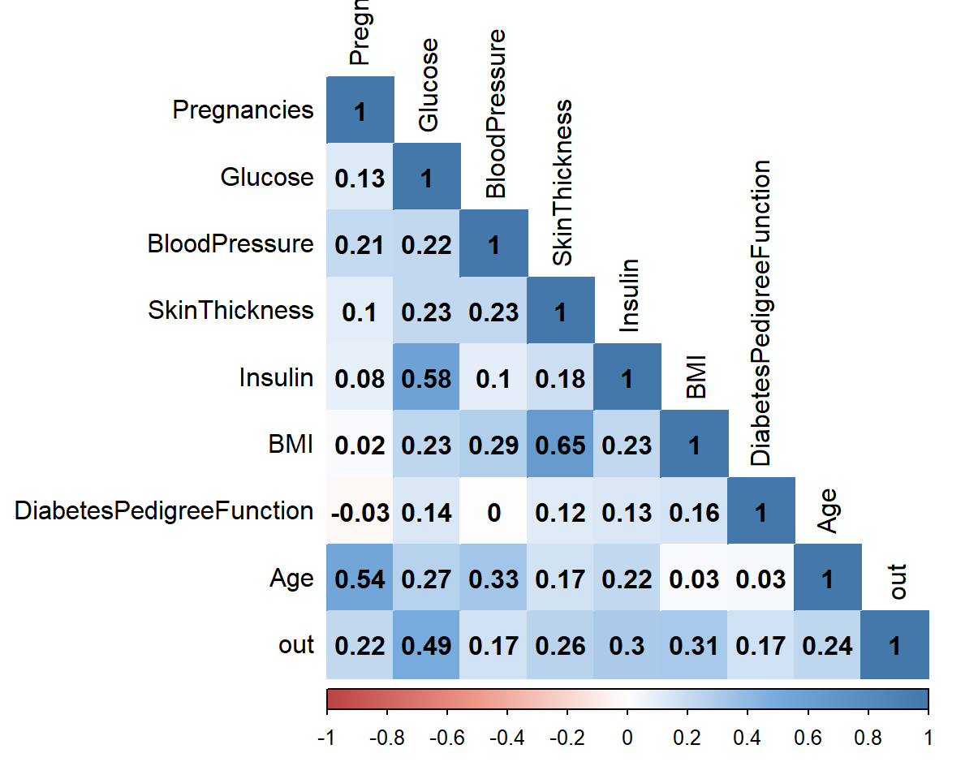
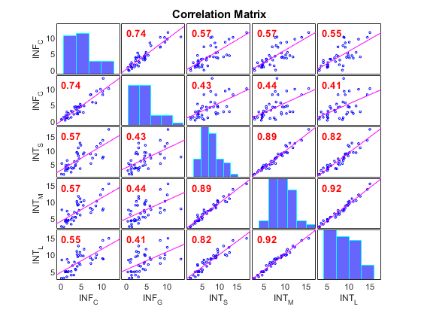
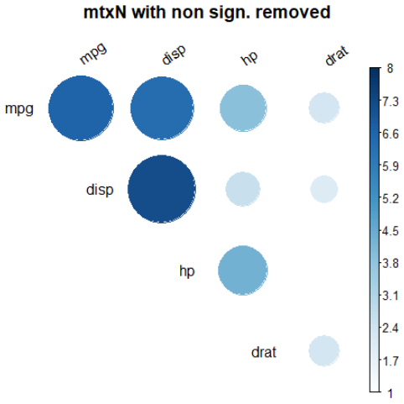
Correlation Plot
corr() function in Python : To find the correlation between two variables in Python we can use the function corr().
DataFrame.corr(method='pearson', min_periods=1)
We can specify the method of correlation in cor() function. i.e. “pearson"," spearman” etc.
cor() can be applied on the data frame also with multiple variables. It will give the correlation between each pair of variables.

Slide 7
Data Visualization

Slide 8
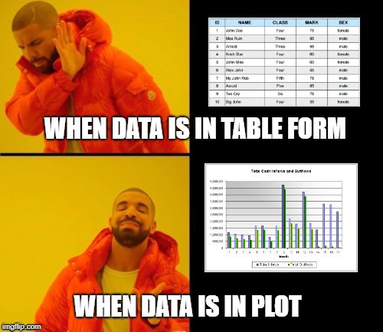
What is Data Visualization?
Data visualization is defined as a graphical representation that contains the information and the data.
By using visual elements like charts, graphs, and maps, data visualization techniques provide an accessible way to see and understand trends, outliers, and patterns in data.
It is used in many areas such as:
  To model complex events.
  It is a powerful technique to explore the data with presentable and interpretable results.
  Visualize phenomenon's that cannot be observed directly, such as weather patterns, medical conditions, or mathematical relationships.

Slide 9
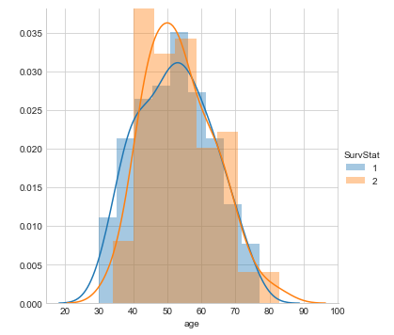
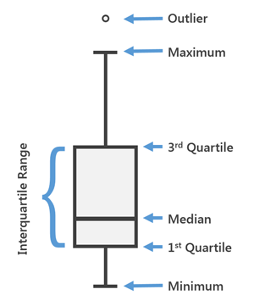
Different Types of Analysis for Data Visualization
Univariate Analysis: In the univariate analysis, we will be using a single feature to analyze almost all its properties.
Distribution Plot is one of the best univariate plots to know about the distribution of data.
This plot gives us a combination of both probability density functions(pdf) and histogram in a single plot.
Box and Whisker plot can be used to obtain more statistical details about the data.
The straight lines at the maximum and minimum are also called whiskers.
Points that lie outside the whiskers will be considered as an outlier.
The box plot also gives us a description of the 25th, 50th,75th quartiles.
sns.FacetGrid(hb,hue='SurvStat',size=5).map(sns.distplot,'age').add_legend()
sns.boxplot(x='SurvStat',y='axil_nodes',data=hb)

Slide 10
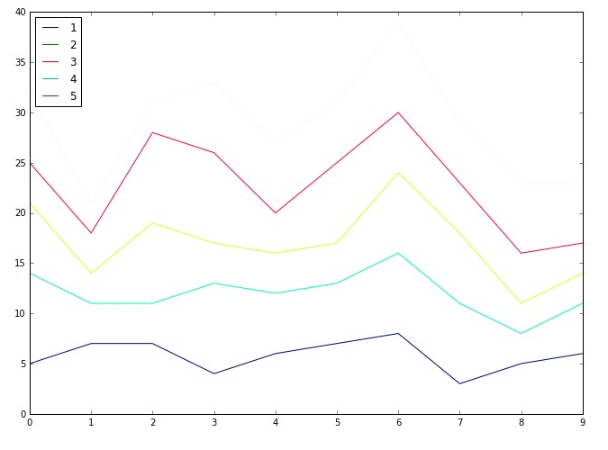
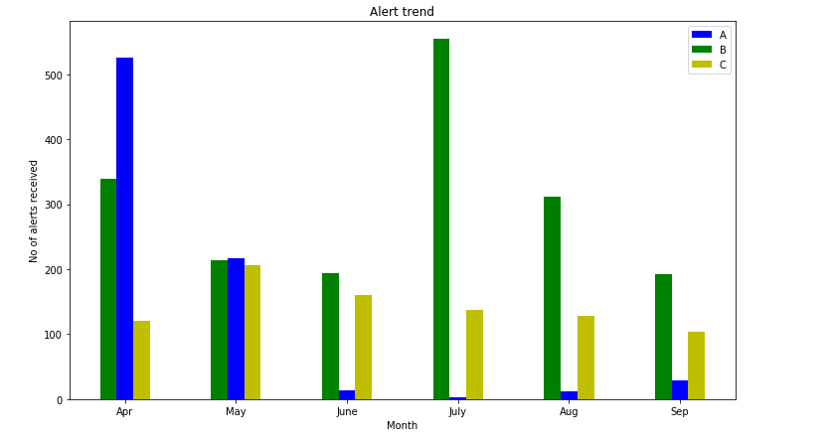
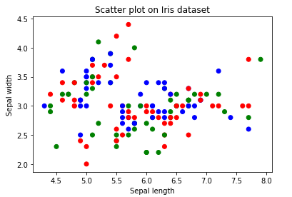
Different Types of Analysis for Data Visualization
Bivariate Analysis: When we compare the data between exactly 2 features then it is known as bivariate analysis.
plt.plot(x,y)
plt.bar(x,y)
plt.scatter(x,y)
The line plots are nothing but the values on a series of data points will be connected with straight lines.
The plot may seem very simple but it has more applications not only in machine learning but in many other areas.
Bar Plot is one of the widely used plots for categorical data.
Though it may seem simple it is powerful in analyzing data like sales figures every week, revenue from a product, Number of visitors to a site on each day of a week, etc.
Scatter Plot describes us as a representation, where each point in the entire dataset is present with respect to any 2 to 3 features (Columns) and use to find the patterns, clusters, and separability of the data.
Scatter plots are available in both 2-D as well as in 3-D.

Slide 11
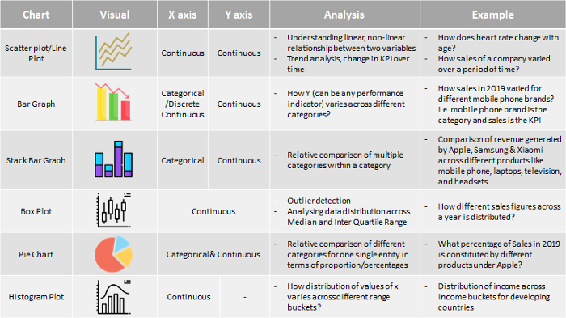
Summarize

Slide 12
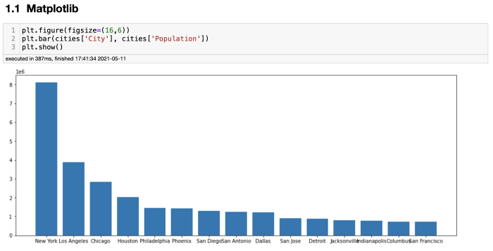
Various Python Libraries used for visualization
Matplotlib
Matplotlib is very easy to set up and remember the code.
Matplotlib supports all the popular charts (lots, histograms, power spectra, bar charts, error charts, scatterplots, etc.) right out of the box. There are also extensions that you can use to create advanced visualizations like 3-Dimensional plots, etc.
However, the chart doesn’t look good. It will probably do the job for data analysis, but its result for a business meeting is not great.

Slide 13
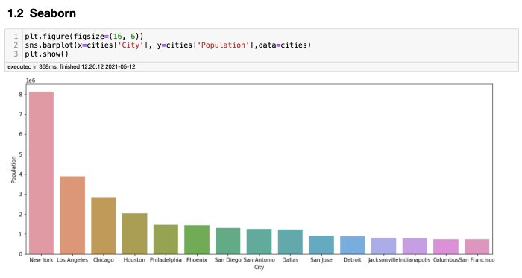
Various Python Libraries used for visualization
Seaborn
When using Seaborn, you will also notice that many of the default settings in the plots work quite well right out of the box, example : It automatically adds x and y-axis labels. The x ticks could look better, but for a basic chart, that's way better than Matplotlib.
Seaborn is built on top of matplotlib and provides a very simple yet intuitive interface for building visualizations.
Seaborn supports a plethora of advanced plots like categorical plotting (catplot), distribution plotting using kde (distplot), swarm plot, etc.

Slide 14
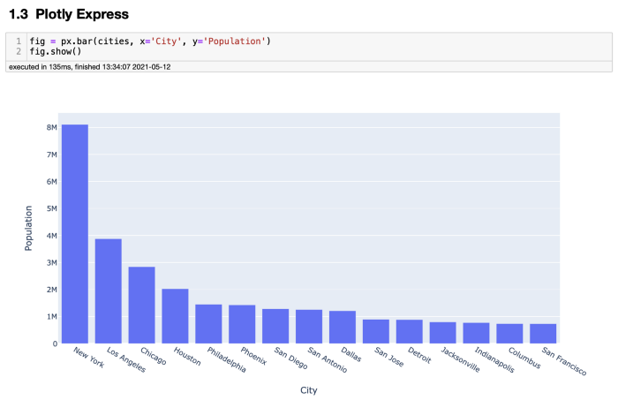
Various Python Libraries used for visualization
Plotly Express
The first thing that comes to my mind when I think about plotly is interactivity! It is used to create visualizations that need to be highly interactive for the user.
Plotly supports a gamut of plots like 3-D plots, Map-based visualizations, scientific plots, etc. The list is endless!

Slide 15
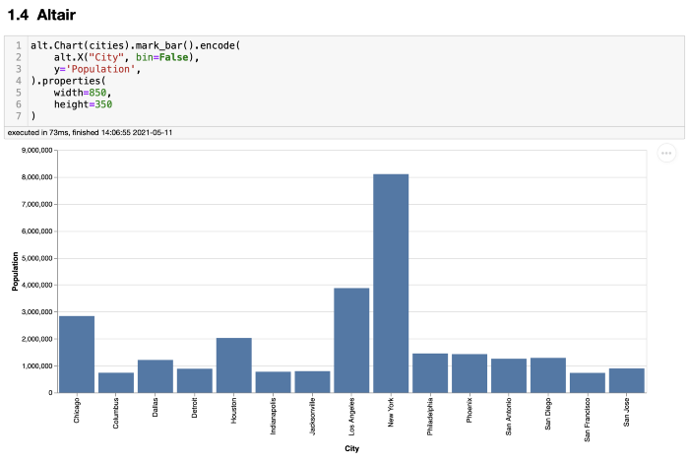
Various Python Libraries used for visualization
Altair
Altair is a declarative library for data visualization.
Its principle is that rather than focusing on the code part, one should focus on the visualization part and write as less code as possible and still be able to create beautiful and intuitive plots. That’s right down my alley!

Slide 16
Assignment
Please download the following datasets :
1. Time series data
https://archive.ics.uci.edu/ml/machine-learning-databases/00597/
2. Categorical dataset (combine white wine and red wine datasets hence, making 2 categories)
    https://archive.ics.uci.edu/ml/machine-learning-databases/wine-quality/
  Plot simple visuals like line chart, bar chart, histogram, scatterplot, correlation plots, pie chart, stacked chart, box plot, dist plot and other relevant plots based on the given data and information.
  Plot complex visuals by combining various simple visuals and add legends, axis and title to it.
  Use customization in plots and make them more presentable.
  Use different data visualization libraries in python like matplotlib, seaborn, plotly,…etc.
  Find 5 insights from each dataset using bivariate and multivariate data analysis graphs also include correlation inferences.
  Submit assignments in a combined Jupyter notebook and rename file as graphical_analysis_name (please replace name with your name)

Slide 17
THANK YOU FOR YOUR
ATTENTATION

